Slide 1
INTRODUCTION TO LOGISTIC REGRESSION

Slide 2
TODAY’S LEARNING OBJECTIVES
INTRODUCTION TO LOGISTIC REGRESSION
Logistic Regression & decision boundaries
Gradient Descent and how it fits into Logistic Regression
Evaluate a model using metrics such as classification accuracy/error, confusion matrix, ROC/AUC curves, and loss functions
Build a Logistic Regression using sklearn

Slide 3
OPENING
MODEL DIFFERENCES

Slide 4

WHERE ARE WE IN THE DATA SCIENCE WORKFLOW?
Data has been acquired and parsed.
Today we’ll refine the data and build models (We’ll also use plots to represent the results).

Slide 5

WHERE ARE WE IN THE MACHINE LEARNING UNIVERSE?

Slide 6
INTRODUCTION
LOGISTIC REGRESSION

Slide 7

LOGISTIC REGRESSION
Logistic regression is a linear approach to solving a classification problem. It will use a linear regression style approach to predict the class of an item, but retain the interpretability of linear regression model.

Slide 8
DEMO
WHY NOT
LINEAR REGRESSION?

Slide 9
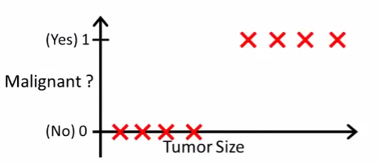
LOGISTIC REGRESSION
Motivation: suppose we want to predict whether a tumor is malignant or benign based on its size.
Decision Boundary
Find where y = 0.5 => x = 2
Anything larger than 2 we will classify as a malignant tumor
Anything less than 2 we will classify as a benign tumor

Slide 10
LOGISTIC REGRESSION
Would Linear Regression work?
Decision Boundary
Find where y = 0.5 => x = 2
Anything larger than 2 we will classify as a malignant tumor
Anything less than 2 we will classify as a benign tumor
0.5
X = 2
What types of problems can you foresee with this technique?

Slide 11

LOGISTIC REGRESSION
Problem 1
Suppose we have another training example, p
Because OLS is minimizing the residuals, it stretches out the line and moves our decision boundary!
These points are now classified as benign!
P
0.5
X = 6

Slide 12
LOGISTIC REGRESSION
Problem 2
Linear Regression outputs predictions < 0 or > 1
Decision Boundary
We want a model that predicts values between 0 and 1
We want a decision boundary AKA “anything past this is class A and anything before it is class B”

Slide 13
INTRODUCTION
LOGISTIC REGRESSION

Slide 14
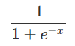
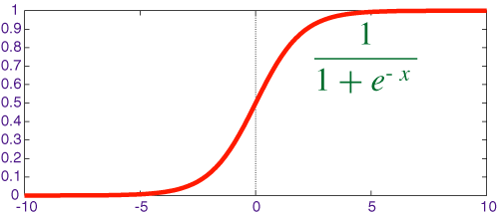
LOGISTIC REGRESSION
We will use Logistic Regression to predict a binary response (0 or 1).
We use the Sigmoid/Logistic function to output probabilities for our predictions. It has the functional form of
This is called our Link function.
We need it in order to find optimal parameters in our model
A standard rule is to classify our “1” class as anything with a probability > 0.5 and our “0” class anything below that.
The point at which the probability = 0.5 is called the decision boundary.
Decision Boundary

Slide 15
TRANSFORMING LINEAR REGRESSION
Intuition: the “linearity” of logistic regression is in the decision boundary we develop. You can imagine it as a line (in 2-D) that separates the two classes.
Questions you’re still thinking
How do we develop this line and what’s the criteria for it? How does it relate to the Sigmoid function?
X2
X1

Slide 16
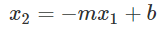
TRANSFORMING LINEAR REGRESSION
Question: how do we develop the decision boundary?
X2
Layman’s definition
We fit a line that best “divides” the two classes
Mathematical definition
We fit a line such that we minimize the sum of the residuals between the true label and the “strength” (aka probability) of our guess.
X1

Slide 17
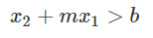
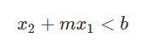
TRANSFORMING LINEAR REGRESSION
X2
We can also rewrite the equation as this:
If then we predict 1.
if then we predict 0
X1

Slide 18
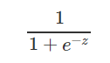
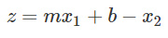
TRANSFORMING LINEAR REGRESSION
Question: how does our decision boundary relate to the sigmoid function?
X2
Where
X1
The sigmoid function outputs values from [0,1] that represent the “strength” aka probability of our prediction

Slide 19

KNOWLEDGE CHECK
Why is Linear Regression not an appropriate tool to use in classification?
How does Logistic Regression account for the failings of Linear Regression?
What is the main criteria for how Logistic Regression develops its decision boundary?
How does the Sigmoid function relate to the decision boundary?
EXERCISE

Slide 20
INTRODUCTION
INTERPRETING
LOGISTIC REGRESSION

Slide 21
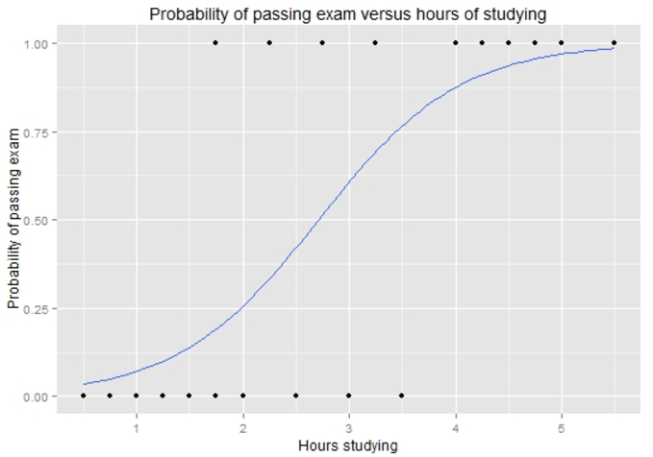
TRANSFORMING LINEAR REGRESSION
Example: how does the number of hours spent studying affect the probability that the student will pass the exam?

Slide 22
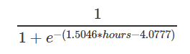
TRANSFORMING LINEAR REGRESSION
Example: how does the number of hours spent studying affect the probability that the student will pass the exam?

Slide 23
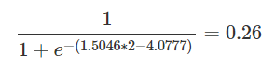
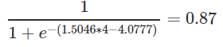
TRANSFORMING LINEAR REGRESSION
For a student who studies 2 hours, the equation gives an estimated probability of passing an exam at 0.26:
While someone that studies for 4 hours, their probability of passing is 0.87:
0.87
0.26
*Standard rule is to predict the “1” class if the probability > 0.5

Slide 24
TRANSFORMING LINEAR REGRESSION
Standard rule is to predict the “1” class if the probability > 0.5
What would you predict for a student that studies 2 hours?
What would you predict for a student that studies 4 hours?
0.87
0.26

Slide 25
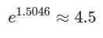
TRANSFORMING LINEAR REGRESSION
How do we interpret the coefficients?
For every 1 hour increase in studying, a student multiplies their odds of passing an exam by:
**Bottom line:** Positive coefficients increase the log-odds of the response (and thus increase the probability), and negative coefficients decrease the log-odds of the response (and thus decrease the probability).

Slide 26
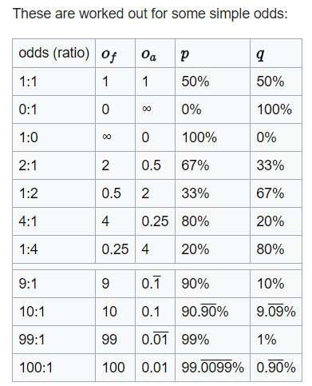
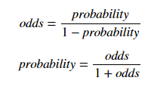
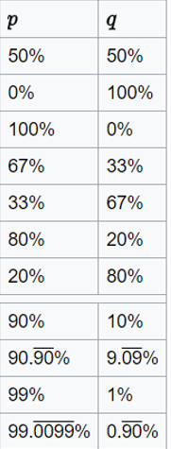
TRANSFORMING LINEAR REGRESSION
Odds represent the likelihood that an event will take place.
What would be the odds for an event with a p = 0.75?
What about the odds for something with a p = 0.40?

Slide 27
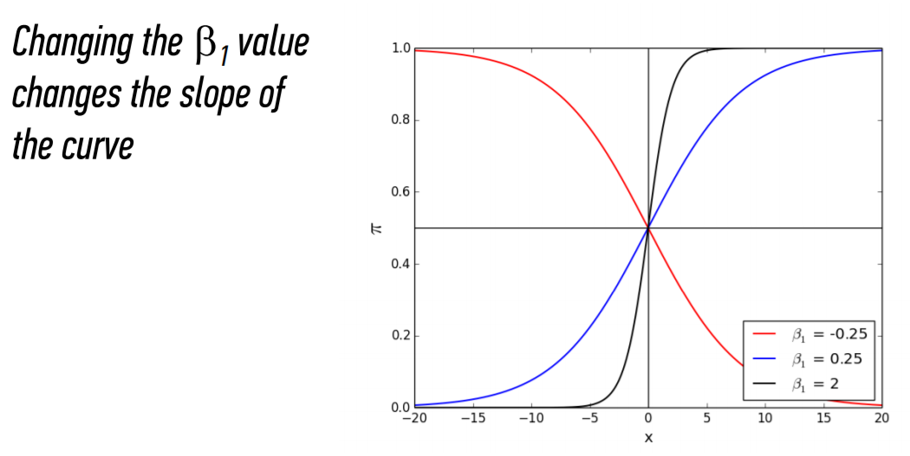
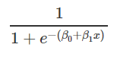
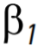
TRANSFORMING LINEAR REGRESSION
The bigger the
the steeper the curve
The smaller the more gradual the curve

Slide 28
INDEPENDENT PRACTICE
MULTICLASS
LOGISTIC REGRESSION

Slide 29
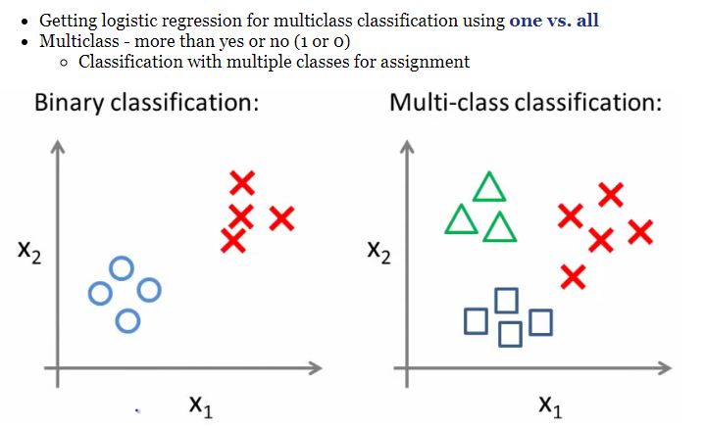
MULTICLASS LOGISTIC REGRESSION

Slide 30
MULTICLASS LOGISTIC REGRESSION
One vs. all classification
Split the training set into three separate binary classification problems
X2
X2
X2
X1
Circle vs. everything else (squares and triangles)
Squares vs. everything else (circles and triangles)
Squares vs. everything else (circles and triangles)

Slide 31
MULTICLASS LOGISTIC REGRESSION
Overall
Train a logistic regression classifier for each class, i.
Make predictions based on which ever model outputs the highest probability for y=1
X2
X1

Slide 32
INTRODUCTION
GRADIENT DESCENT

Slide 33
GRADIENT DESCENT
Intuition: how do we find the decision boundary that best separates our two classes?
AKA what are the coefficients for the linear boundary?
We want to build a decision boundary that best divides the two classes. There are two ways we can think of this:
We fit a line such that we minimize the sum of the residuals between the true label and the “strength” (aka probability) of our guess.
(2) We optimize the probabilities
We make our probabilities as large as possible when y = 1.
We make our probabilities as small as possible when y = 0.
Y
Y = -2.5x + 30
Y = -2.3x + 20
Y = -3x + 40
X

Slide 34
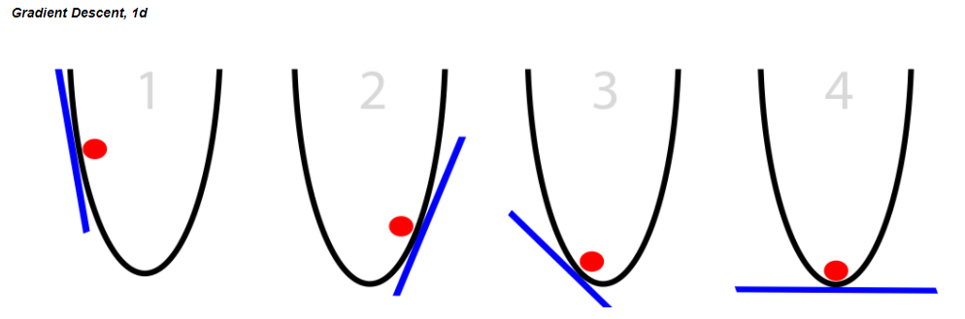
GRADIENT DESCENT
Gradient Descent is an iterative process that we use to pick our decision boundary
You can see it as almost a guess and check – do these sets of coefficients minimize the error between my guess and the true point? If no, then keep looking for better coefficients. If yes, then stop!
The y-axis represents the residuals AKA the cost function, and the x-axis represents our parameters for the decision boundary
Notice how there is only one point that minimizes the cost function

Slide 35
GRADIENT DESCENT
A random linear solution is provided as a starting point (usually a "flat" line or solution)
The solver then attempts to find a next step: we take a step in any direction and measure each performance.
If the solver finds a better solution (optimizing toward a metric such as mean squared error), this is the new starting point.
Repeat these steps until the performance is optimized and no "next steps" perform better. The size of the steps will shrink over time.
Because we’ve minimized the residuals at this point, the set of parameters we use to define our decision boundary are here!

Slide 36

DOES THE CURVE LOOK FAMILIAR?

Slide 37
LOGISTIC REGRESSION
Advantages of logistic regression
Highly interpretable (if you remember how)
Model training and prediction are fast
No tuning is required (excluding regularization)
Features don't need scaling
Can perform well with a small number of observations
Outputs well-calibrated predicted probabilities
Disadvantages of logistic regression
Presumes a linear relationship between the features and the log-odds of the response
Performance is (generally) not competitive with the best supervised learning methods
Can't automatically learn feature interactions

Slide 38
INTRODUCTION
ADVANCED CLASSIFICATION METRICS

Slide 39
ADVANCED CLASSIFICATION METRICS
What if we wanted to know exactly how a classifier was performing (e.g. what is predicting correctly vs incorrectly)?

Slide 40
THE CONFUSION MATRIX
Confusion matrices allow for the interpretation of correct and incorrect predictions for each class label.
It is the first step for the majority of classification metrics and goes deeper than just accuracy.

Slide 41
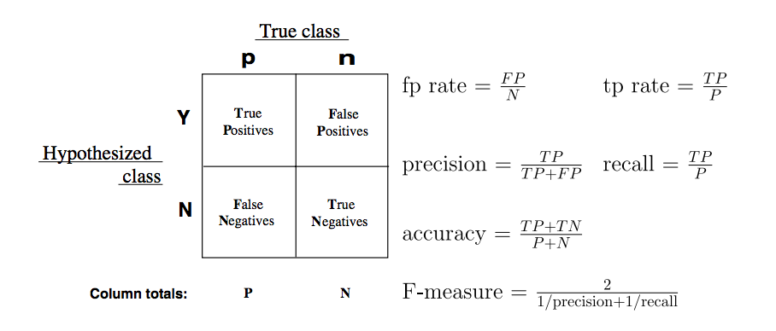
INTRO TO THE CONFUSION MATRIX
Let’s review our confusion matrix.
Prediction
Actual Values

Slide 42
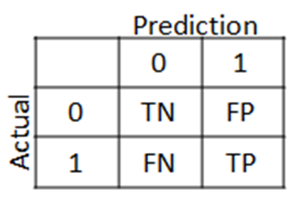
ADVANCED CLASSIFICATION METRICS
We can use a confusion matrix to obtain more granular accuracy ratings for of each class by using the true positive rate and the false positive rate.

Slide 43
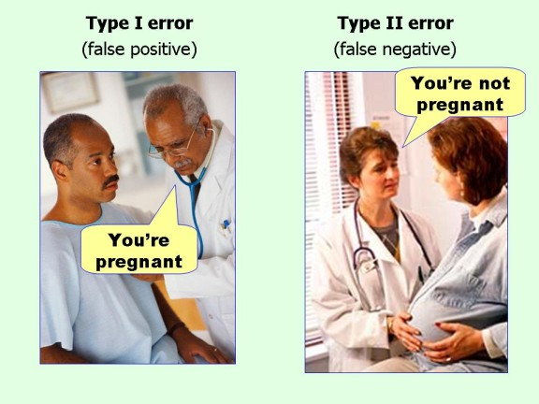
Confusion Matrix – Error Types

Slide 44
ADVANCED CLASSIFICATION METRICS
Predictions
Not Pregnant
Pregnant
What are the number of true positives?
What are the number of false negatives?
What are the number of false positives?
What are the number of true negatives?
50 | 24
10 | 62
Not Pregnant
True Class
Pregnant

Slide 45
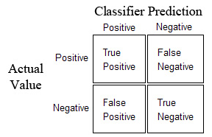
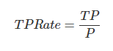
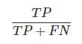
ADVANCED CLASSIFICATION METRICS
The true positive rate (TPR) asks, “Out of all of the target classes, how many were accurately predicted to belong to that class?”
Using our example, the TPR would be how often does our model correctly identify customer who will default on their credit card debt.

Slide 46
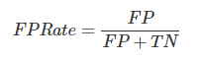
ADVANCED CLASSIFICATION METRICS
The false positive rate (FPR) asks, “Out of all items not belonging to a class, how many were predicted as belonging to that target class label?”
Using our example, the FPR would be how often the model predict that a customer will default when they end up not doing so.

Slide 47
PRECISION AND RECALL
Our previous metrics were primarily designed for less biased data problems: we could be interested in both outcomes, so it was important to generalize our approach.
For example, we may be interested if a person will vote for a Republican or Democrat. This is a binary problem, but we’re interested in both outcomes.

Slide 48
PRECISION AND RECALL
Precision and recall, metrics built from the confusion matrix, focus on information retrieval, particularly when one class is more interesting than the other.
For example, we may want to predict if a person will be a customer. We care much more about people who will be a customer of ours than people who won’t.

Slide 49
PRECISION AND RECALL
Precision aims to product a high amount of relevancy instead of irrelevancy.
Precision asks, “Out of all of our positive predictions (both true positive and false positive), how many were correct?”
Recall aims to see how well a model returns specific data (literally, checking whether the model can recall what a class label looked like).
Recall asks, “Out of all of our positive class labels, how many were correct?”

Slide 50
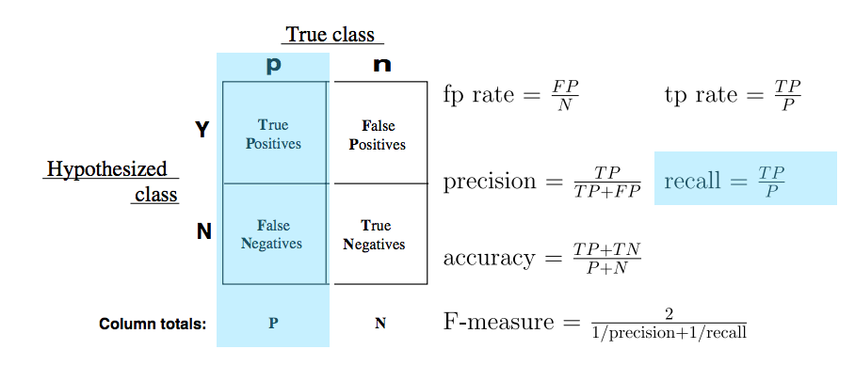
THE MATH FOR RECALL
Recall is the count of predicted true positives over the total count of that class label.
This is the same as True Positive Rate or sensitivity.
Prediction
Actual Values

Slide 51
THE MATH FOR RECALL
Imagine predicting the color of a marble as either red or green. There are 10 of each.
If the model identifies 8 identifies 8 of the green marbles as green, the recall is 8 / 10 = 0.80.
However, this says nothing of the number of red marbles that are also identified as green.

Slide 52
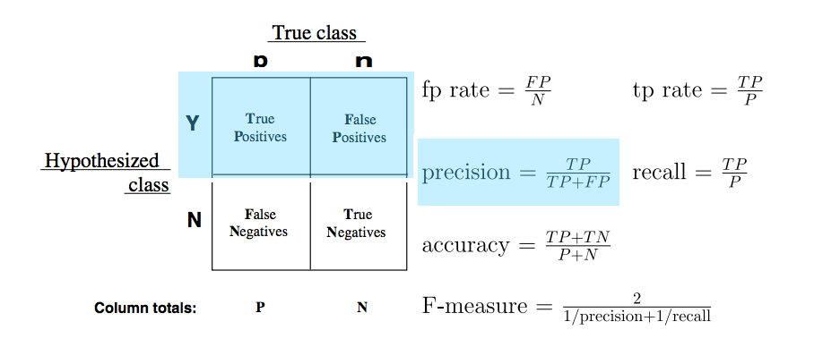
THE MATH FOR PRECISION
Precision, or positive predicted value, is calculated as the count of predicted true positives over the count of all values predicted to be positive.
Prediction
Actual Values

Slide 53
THE MATH FOR PRECISION
Let’s use our marble example again.
If a model predicts 8 of the green marbles as green, then precision would be 1.00, because all marbles predicted as green were in fact green.
Let’s assume all red marbles were predicted correctly, and 2 green were predicted as red.
The precision of red marbles would be 10 / (10 + 2) = 0.833.

Slide 54
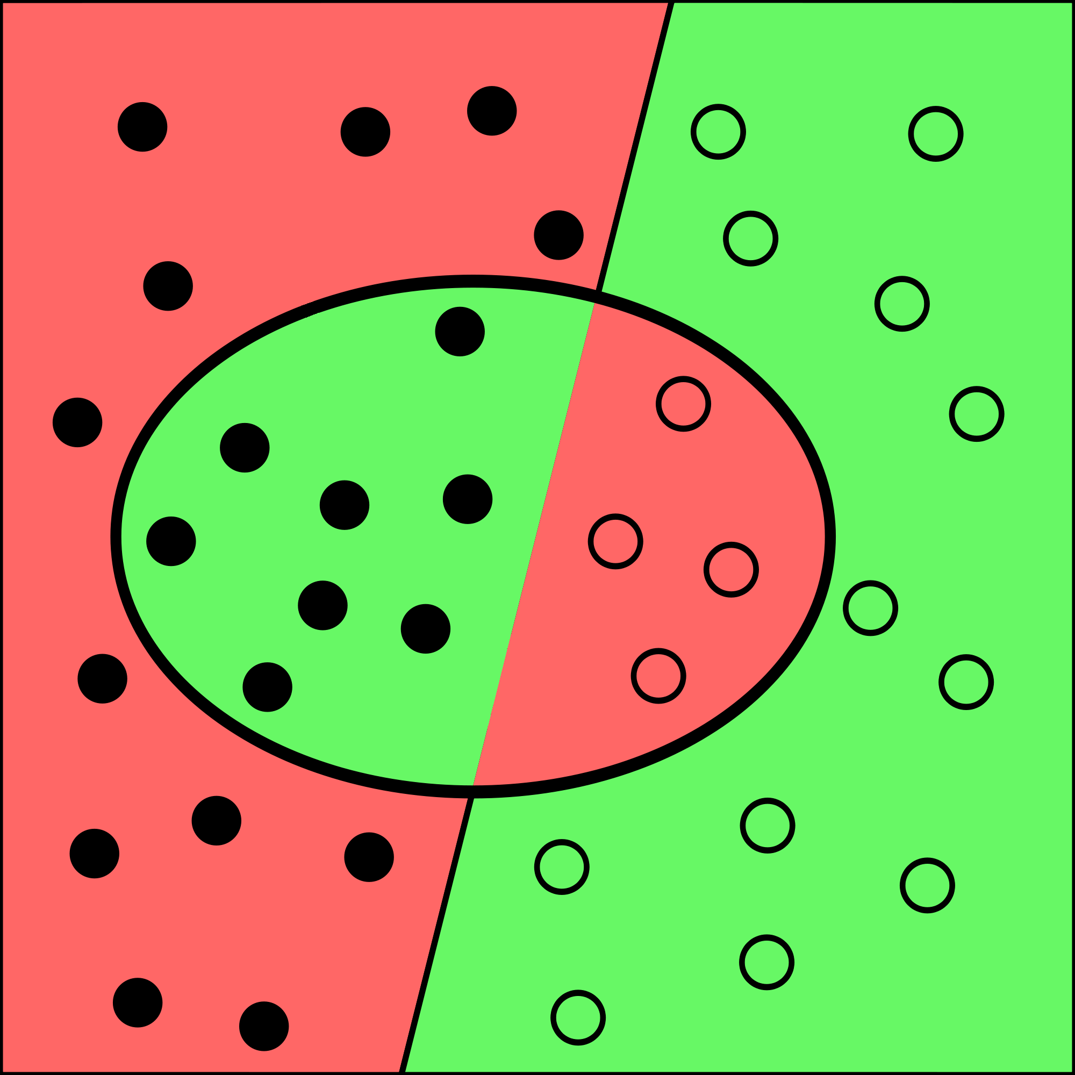
ANOTHER EXAMPLE
Imagine we have another marble problem where we consider green to be our positive class. The diagram to the right shows our results.
Shaded circles represent correct predictions (e.g. green was predicted as green).
Unshaded circles represent incorrect predictions (e.g. green was predicted red).

Slide 55
ANOTHER EXAMPLE
The background shows the color predicted.
A shaded circle on a green background represents a green marble that was predicted as green.
An unshaded circle on a red background represents a red marble that was predicted as green.

Slide 56
ANOTHER EXAMPLE
For this example, we would have the following confusion matrix.
We could calculate precision for green marbles as 8 / (8 + 4) = 0.6666.
We could calculate recall for green marbles as 8 / (8 + 12) = 0.4000.
 |  | True Class
 |  | Green | Red
Predicted Class | Green | 8 | 4
 | Red | 12 | 12

Slide 57
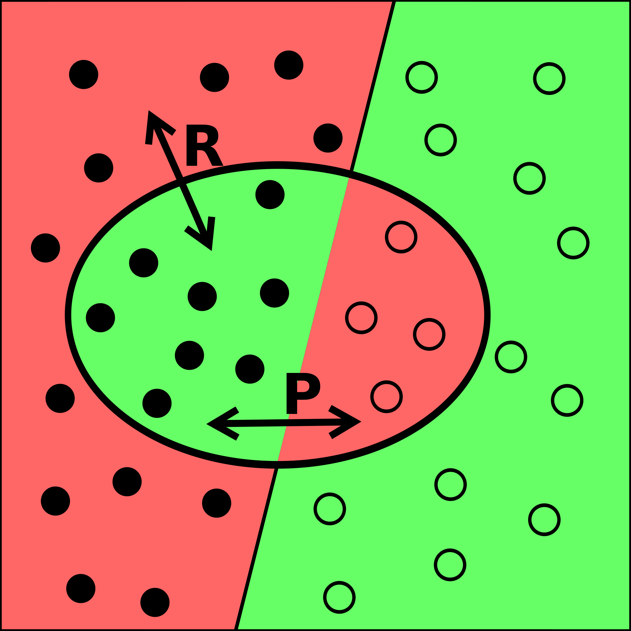
ANOTHER EXAMPLE
We could update our diagram to reflect these calculations.
Notice we don’t talk about the red marbles predicted as green.
We’ve chosen to focus on our model’s accuracy as it relates to predicting green marbles.

Slide 58
INTRODUCTION
ROC CURVE

Slide 59
THE ROC CURVE
This is where the Receiver Operation Characteristic (ROC) curve comes in handy.
The curve is created by plotting the TPR against the FPR at various probability thresholds.
This is where we toggle our threshold of p = 0.5
Area Under the Curve (AUC) summarizes the impact of TPR and FPR in a single value.

Slide 60
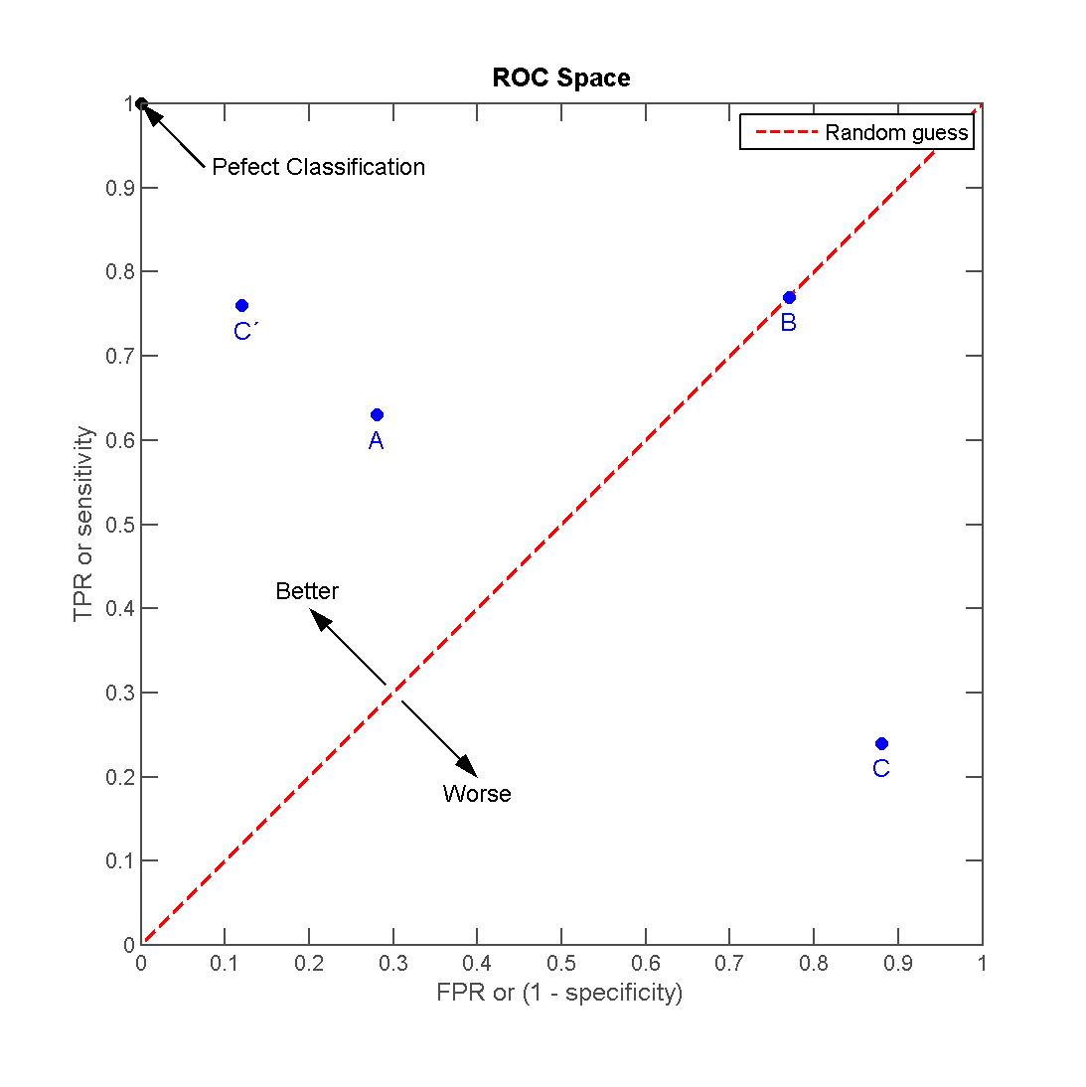
THE ROC CURVE
There can be a variety of points on an ROC curve.
Each point is determined by a unique probability threshold

Slide 61
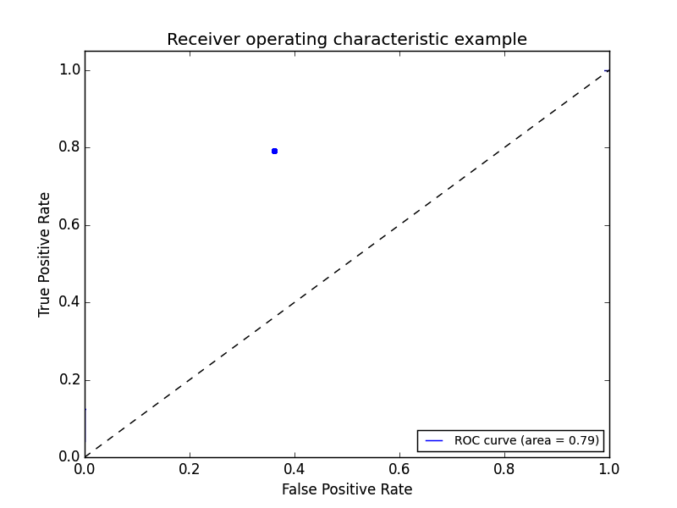
THE ROC CURVE
We can begin by plotting an individual TPR/FPR pair for one threshold.
Let’s say this is for a default p = 0.5

Slide 62
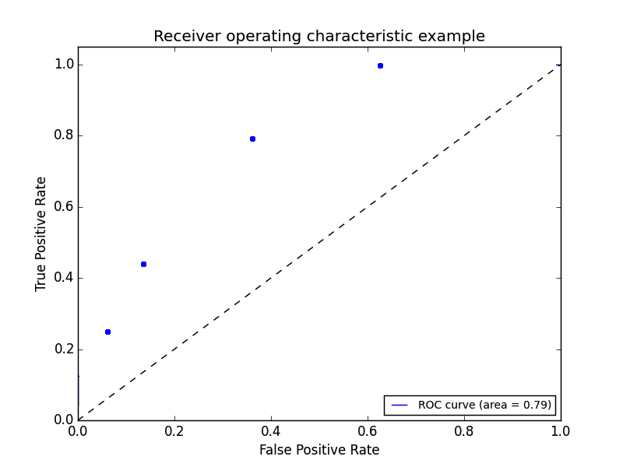
THE ROC CURVE
We can continue adding pairs for different thresholds.
Let’s say we wanted to set a probability threshold of p > 0.9. AKA I’m only making a prediction of class ‘0’ when the model outputs a probability that’s > 0.9.
- Which point would best represent this case?

Slide 63
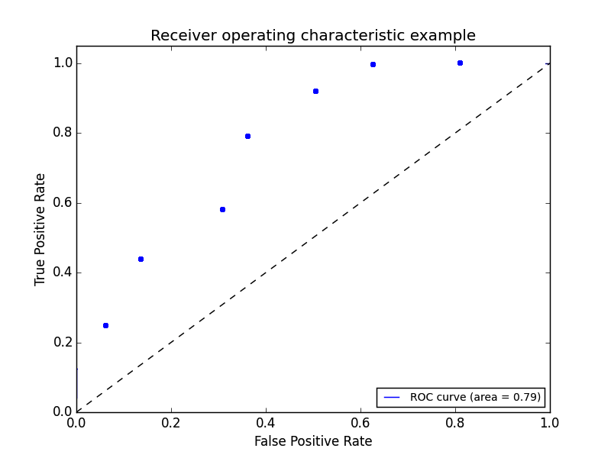
THE ROC CURVE
We can continue adding pairs for even more thresholds.

Slide 64
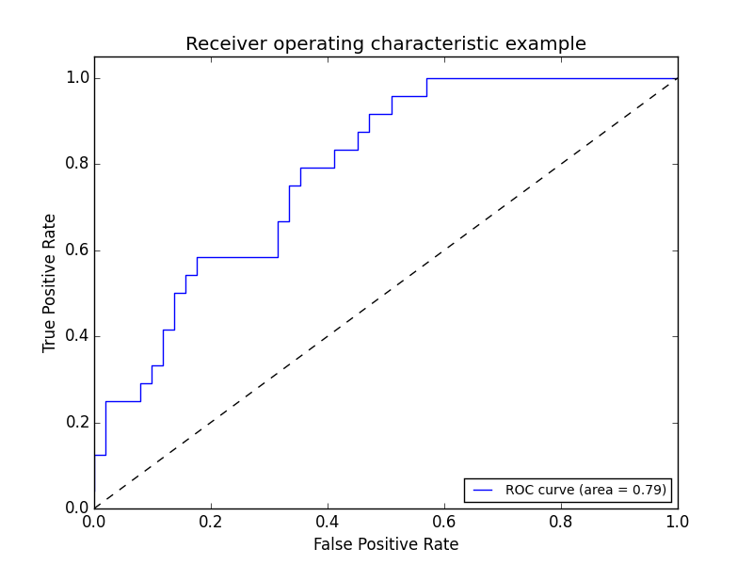
THE ROC CURVE
Finally, we create a full “curve” that is described by both TPR and FPR.

Slide 65
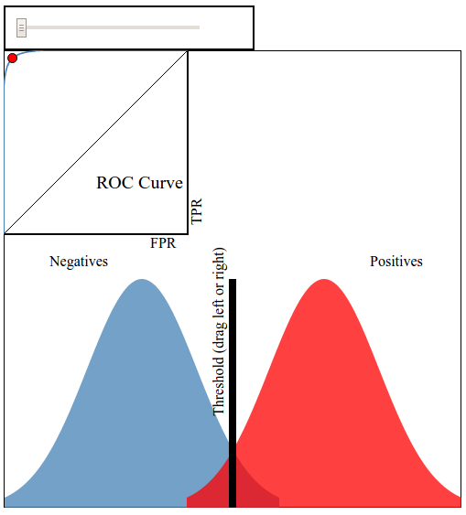
THE ROC CURVE
This interactive visualization can help practice visualizing ROC curves.

Slide 66
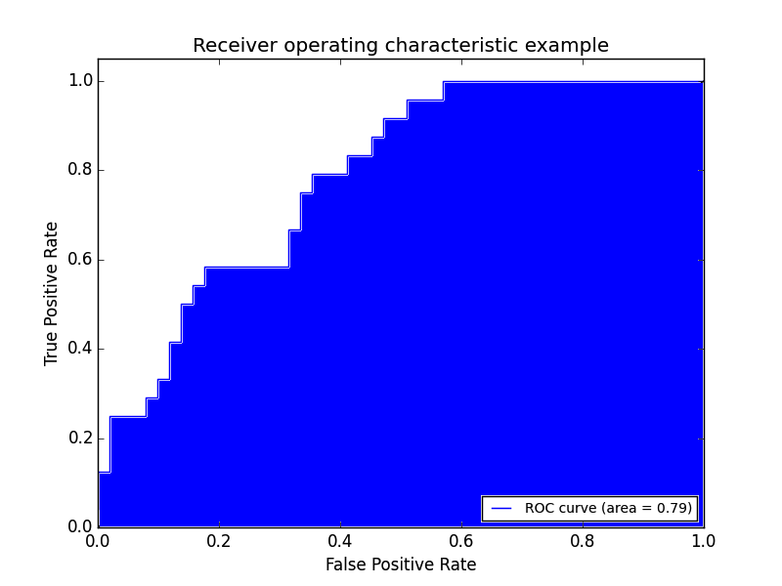
AREA UNDER THE CURVE
With this curve, we can find the Area Under the Curve (AUC).
As you increase your sensitivity (true positives) and can identify more cases with a certain condition, you also sacrifice accuracy on identifying those without the condition (specificity).

Slide 67
CONCLUSION
TOPIC REVIEW

Slide 68
REVIEW QUESTIONS
What’s the link function used for in logistic regression?
What criteria do we use to create our decision boundary?
What do the coefficients in a logistic regression represent? How does the interpretation differ from ordinary least squares? How is it similar?
How do we implement a multivariate logistic regression?
How does True Positive Rate and False Positive Rate help explain accuracy?

Slide 69
Knowledge Review Section
Can you answer these questions for mastery?

Slide 70
CALCULATING ALL THREE
Probability is the probability an event happens. For example, there might be an 80% chance of rain today.
Odds (more technically the odds of success) is defined as probability of success/probability of failure. So the odds of a success (80% chance of rain) has an accompanying odds of failure (20% chance it doesn’t rain); as an equation (the “odds ratio“), that’s .8/.2 = 4.
Log odds is the logarithm of the odds. Ln(4) = 1.38629436 ≅ 1.386.

Slide 71
ACTIVITY: NEVER TELL ME THE ODDS
ANSWER THE FOLLOWING QUESTIONS
EXERCISE
Given a standard deck of cards, calculate the probability and odds of obtaining the following cards
The 2 of clubs
Any diamond card
A face card (any J, Q, K)
What do each of these measures tell you about how likelihood of each scenario?

Slide 72
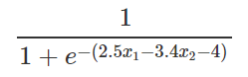
KNOWLEDGE CHECK
DIRECTIONS (5 minutes)
Suppose we’re trying to predict whether a widget is defective based on its manufacturing time in hours, x₁ , and number of dongles, x₂. We run a Logistic Regression (where a “1” means the widget is defective and “0” means it is not defective) on a dataset and get the following sigmoid function:
What’s the probability of a defective dongle when the manufacturing time is 2 hours and there are 5 dongles?
What happens to the odds of a widget being defective as we increase the number of dongles by 1 unit?
What happens to the odds of a widget being defective as we increase the manufacturing time by 1 unit?
EXERCISE

Slide 73
KNOWLEDGE CHECK
What do all of the points on the ROC curve represent?
As we decrease our probability threshold, we (increase/decrease) our true positive rate and (increase/decrease) our false positive rate.
An AUC (Area under the curve) close to 0.5 means our model is (good/bad)?
An AUC (Area under the curve) close to 1 means our model is (good/bad)?
EXERCISE

Slide 74
ACTIVITY: KNOWLEDGE CHECK
ANSWER THE FOLLOWING QUESTIONS
EXERCISE
What would the precision and recall be for the following confusion matrix (with “green” being “true”)?
 | predicted_green | predicted_not_green
is_green | 13 | 7
is_not_green | 8 | 12
DELIVERABLE
Answers to the above question

Slide 75
ACTIVITY
For each of the example:
Write a confusion matrix: true positive, false positive, true negative, false negative. Then decide what each square represents for that specific example.
Examples:
A test is developed for determining if a patient has cancer or not.
A newspaper company is targeting a marketing campaign for "at risk" users that may stop paying for the product soon.
You build a spam classifier for your email system.
EXERCISE

